Slide 1
Pipes
Lesson09
Notes:
Add instructor notes here.

Slide 2
Lesson Objectives
What is a pipe?
Passing parameters to a pipe
Chaining pipes
Developing a custom pipe
Notes:
Add instructor notes here.

Slide 3
Pipe
A pipe takes in data as input and transforms it to a desired output.
Pipes transform bound properties before they are displayed
Angular pipes, a way to write display-value transformations that we can declare in your HTML.
To pass an argument to a pipe in the HTML form, pass it with a colon after the pipe (for multiple arguments, simply append a colon after each argument)
Angular gives us several built-in pipe like lowercase, date, number, decimal, percent, currency, json, slice etc
Angular provides a way to create custom pipes as well.
Notes:
Pipes are used when the data is not in a format appropriate for display
Add instructor notes here.

Slide 4
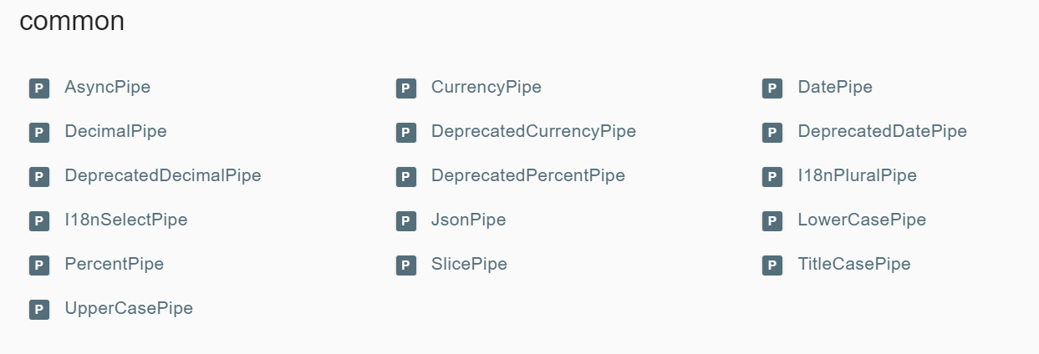
Build in Pipes
https://angular.io/api?type=pipe-- We Can see all Build in Pipes
Notes:
Angular comes with a stock of pipes such as DatePipe, UpperCasePipe, LowerCasePipe, CurrencyPipe, and PercentPipe. They are all available for use in any template.
Angular doesn't have a FilterPipe or an OrderByPipe

Slide 5
Chaining Pipes & Parameterizing a pipe
We can chain pipes together in potentially useful combinations.
A pipe may accept any number of optional parameters to fine-tune its output. We add parameters to a pipe by following the pipe name with a colon ( : ) and then the parameter value (e.g., currency:’EUR’). If our pipe accepts multiple parameters, we separate the values with colons (e.g. slice:1:5).
<tr *ngFor="let emp of employess" >
<td>{{emp.empId}}</td>
<td>{{emp.empName |uppercase | slice:1:3}}</td> <!-- Channing pipes & passing parameter -->
<td>{{emp.empSal | currency:'USD':true}}</td> <!-- Currency pipes -->
<td>{{emp.empDep}}</td>
<td>{{emp.empjoiningdate | date:'fullDate'|uppercase}}</td> <!-- Dates pipes channing pipes -->
Notes:
A pipe can accept any number of optional parameters to fine-tune its output. To add parameters to a pipe, follow the pipe name with a colon ( : ) and then the parameter value (such as currency:'EUR'). If the pipe accepts multiple parameters, separate the values with colons (such as slice:1:5)
You can chain pipes together in potentially useful combinations. In the following example, to display the birthday in uppercase, the birthday is chained to the DatePipe and on to the UpperCasePipe. The birthday displays as APR 15, 1988.
The chained hero's birthday is {{ birthday | date | uppercase}}

Slide 6
Custom Pipes
A pipe is a class decorated with pipe metadata.
The pipe class implements the PipeTransform interface's transform method that accepts an input value followed by optional parameters and returns the transformed value.
There will be one additional argument to the transform method for each parameter passed to the pipe. Your pipe has one such parameter: the exponent.
Notes:
This pipe definition reveals the following key points:
A pipe is a class decorated with pipe metadata.
The pipe class implements the PipeTransform interface's transform method that accepts an input value followed by optional parameters and returns the transformed value.
There will be one additional argument to the transform method for each parameter passed to the pipe. Your pipe has one such parameter: the exponent.
To tell Angular that this is a pipe, you apply the @Pipe decorator, which you import from the core Angular library.
The @Pipe decorator allows you to define the pipe name that you'll use within template expressions. It must be a valid JavaScript identifier. Your pipe's name is exponentialStrength.
We use the transform method to do any logic necessary to convert the valuethat is being passed in. We can get ahold of the arguments array as the second parameter and pass in as many as we like from the template.
The PipeTransform interface
The transform method is essential to a pipe. The PipeTransform interface defines that method and guides both tooling and the compiler. Technically, it's optional; Angular looks for and executes the transform method regardless.
Add instructor notes here.

Slide 7
Custom Pipes
To tell Angular that this is a pipe, you apply the @Pipe decorator, which you import from the core Angular library.
The @Pipe decorator allows you to define the pipe name that you'll use within template expressions. It must be a valid JavaScript identifier.
import {PipeTransform,Pipe} from 'angular2/core';
@Pipe({ name : 'customPipe'})
export class ExponentialStengthPipe implements PipeTransform{ transform(value:number,args:string[]):any {
return Math.pow(value,parseInt(args[0] || ‘1’, 10));
}
}
Notes:
In share/pipes folder, create a new .ts file named trim.pipe.ts
Import from ‘angular/core’ the module Pipe and PipeTransform. We tell Angular that this is a pipe by applying the @Pipe decorator which we import from the core Angular library.1
import {Pipe, PipeTransform} from '@angular/core';
Creating The pipe class implements the PipeTransform interface’s transform method that accepts an input value followed by optional parameters and returns the transformed value.
The @Pipe decorator allows us to define the pipe name that we’ll use within template expressions. It must be a valid JavaScript identifier. We should be always use the “PipeTransform” interface, which forces us to have a transform() method.
The transform method is essential to a pipe. The PipeTransforminterface defines that method and guides both tooling and the compiler. It is technically optional; Angular looks for and executes the transform method regardless.
How to use a Custom Pipe
1. We use our custom pipe the same way we use the built-in pipes. 2. We must include our pipe in the pipes array of the @Component decorator.

Slide 8
Demo
DemoBuildInPipes
DemoCustomPipe
Notes:
Add the notes here.
Add instructor notes here.

Slide 9
Lab
Lab 4.2
Notes:
Add the notes here.
Add instructor notes here.

Slide 10
Summary
A pipe takes in data as input and transforms it to a desired output.
Pipes transform bound properties before they are displayed
Angular pipes, a way to write display-value transformations that we can declare in your HTML.
We can chain pipes together in potentially useful combinations.
A pipe is a class decorated with pipe metadata.
The pipe class implements the PipeTransform interface's transform method that accepts an input value followed by optional parameters and returns the transformed value.
Notes:
Add instructor notes here.

